Slide 1
Simplifying multiplication and division using multiples of 10
Arithmetic procedures with integers and decimals

Slide 2
how to use Oak lessons

Slide 3
I can factorise multiples of 10^{n} in order to simplify multiplication and division of both integers and decimals.

Slide 4
A product is the result of two or more numbers multiplied together.
Partitioning is the act of splitting an object or value down into smaller parts.

Slide 5

Simplifying multiplication and division using multiples of 10
Simplifying multiplication using multiples of 10
Simplifying division using multiples of 10

Slide 6
Simplifying multiplication using multiples of 10
Here is a Gattegno chart
1000 |  | 2000 |  | 3000 |  | 4000 |  | 5000 |  | 6000 |  | 7000 |  | 8000 |  | 9000
100 |  | 200 |  | 300 |  | 400 |  | 500 |  | 600 |  | 700 |  | 800 |  | 900
10 |  | 20 |  | 30 |  | 40 |  | 50 |  | 60 |  | 70 |  | 80 |  | 90
1 |  | 2 |  | 3 |  | 4 |  | 5 |  | 6 |  | 7 |  | 8 |  | 9
0 | .1 | 0 | .2 | 0 | .3 | 0 | .4 | 0 | .5 | 0 | .6 | 0 | .7 | 0 | .8 | 0 | .9
0 | .01 | 0 | .02 | 0 | .03 | 0 | .04 | 0 | .05 | 0 | .06 | 0 | .07 | 0 | .08 | 0 | .09
1000 |  | 2000 |  | 3000 |  | 4000 |  | 5000 |  | 6000 |  | 7000 |  | 8000 |  | 9000
100 |  | 200 |  | 300 |  | 400 |  | 500 |  | 600 |  | 700 |  | 800 |  | 900
10 |  | 20 |  | 30 |  | 40 |  | 50 |  | 60 |  | 70 |  | 80 |  | 90
1 |  | 2 |  | 3 |  | 4 |  | 5 |  | 6 |  | 7 |  | 8 |  | 9
0 | .1 | 0 | .2 | 0 | .3 | 0 | .4 | 0 | .5 | 0 | .6 | 0 | .7 | 0 | .8 | 0 | .9
0 | .01 | 0 | .02 | 0 | .03 | 0 | .04 | 0 | .05 | 0 | .06 | 0 | .07 | 0 | .08 | 0 | .09
1000 |  | 2000 |  | 3000 |  | 4000 |  | 5000 |  | 6000 |  | 7000 |  | 8000 |  | 9000
100 |  | 200 |  | 300 |  | 400 |  | 500 |  | 600 |  | 700 |  | 800 |  | 900
10 |  | 20 |  | 30 |  | 40 |  | 50 |  | 60 |  | 70 |  | 80 |  | 90
1 |  | 2 |  | 3 |  | 4 |  | 5 |  | 6 |  | 7 |  | 8 |  | 9
0 | .1 | 0 | .2 | 0 | .3 | 0 | .4 | 0 | .5 | 0 | .6 | 0 | .7 | 0 | .8 | 0 | .9
0 | .01 | 0 | .02 | 0 | .03 | 0 | .04 | 0 | .05 | 0 | .06 | 0 | .07 | 0 | .08 | 0 | .09
The product of the pair of numbers highlighted is 21.
Find more pairs of numbers, on the chart, with a product of 21.

Slide 7
Simplifying multiplication using multiples of 10
Here is a Gattegno chart
1000 |  | 2000 |  | 3000 |  | 4000 |  | 5000 |  | 6000 |  | 7000 |  | 8000 |  | 9000
100 |  | 200 |  | 300 |  | 400 |  | 500 |  | 600 |  | 700 |  | 800 |  | 900
10 |  | 20 |  | 30 |  | 40 |  | 50 |  | 60 |  | 70 |  | 80 |  | 90
1 |  | 2 |  | 3 |  | 4 |  | 5 |  | 6 |  | 7 |  | 8 |  | 9
0 | .1 | 0 | .2 | 0 | .3 | 0 | .4 | 0 | .5 | 0 | .6 | 0 | .7 | 0 | .8 | 0 | .9
0 | .01 | 0 | .02 | 0 | .03 | 0 | .04 | 0 | .05 | 0 | .06 | 0 | .07 | 0 | .08 | 0 | .09
1000 |  | 2000 |  | 3000 |  | 4000 |  | 5000 |  | 6000 |  | 7000 |  | 8000 |  | 9000
100 |  | 200 |  | 300 |  | 400 |  | 500 |  | 600 |  | 700 |  | 800 |  | 900
10 |  | 20 |  | 30 |  | 40 |  | 50 |  | 60 |  | 70 |  | 80 |  | 90
1 |  | 2 |  | 3 |  | 4 |  | 5 |  | 6 |  | 7 |  | 8 |  | 9
0 | .1 | 0 | .2 | 0 | .3 | 0 | .4 | 0 | .5 | 0 | .6 | 0 | .7 | 0 | .8 | 0 | .9
0 | .01 | 0 | .02 | 0 | .03 | 0 | .04 | 0 | .05 | 0 | .06 | 0 | .07 | 0 | .08 | 0 | .09
1000 |  | 2000 |  | 3000 |  | 4000 |  | 5000 |  | 6000 |  | 7000 |  | 8000 |  | 9000
100 |  | 200 |  | 300 |  | 400 |  | 500 |  | 600 |  | 700 |  | 800 |  | 900
10 |  | 20 |  | 30 |  | 40 |  | 50 |  | 60 |  | 70 |  | 80 |  | 90
1 |  | 2 |  | 3 |  | 4 |  | 5 |  | 6 |  | 7 |  | 8 |  | 9
0 | .1 | 0 | .2 | 0 | .3 | 0 | .4 | 0 | .5 | 0 | .6 | 0 | .7 | 0 | .8 | 0 | .9
0 | .01 | 0 | .02 | 0 | .03 | 0 | .04 | 0 | .05 | 0 | .06 | 0 | .07 | 0 | .08 | 0 | .09
Let’s start with the factor pair of 21.
3 × 7
Notice the number in the 3rd column went up one and the one in the 7th column went down one.

Slide 8
Simplifying multiplication using multiples of 10
Here is a Gattegno chart
1000 |  | 2000 |  | 3000 |  | 4000 |  | 5000 |  | 6000 |  | 7000 |  | 8000 |  | 9000
100 |  | 200 |  | 300 |  | 400 |  | 500 |  | 600 |  | 700 |  | 800 |  | 900
10 |  | 20 |  | 30 |  | 40 |  | 50 |  | 60 |  | 70 |  | 80 |  | 90
1 |  | 2 |  | 3 |  | 4 |  | 5 |  | 6 |  | 7 |  | 8 |  | 9
0 | .1 | 0 | .2 | 0 | .3 | 0 | .4 | 0 | .5 | 0 | .6 | 0 | .7 | 0 | .8 | 0 | .9
0 | .01 | 0 | .02 | 0 | .03 | 0 | .04 | 0 | .05 | 0 | .06 | 0 | .07 | 0 | .08 | 0 | .09
1000 |  | 2000 |  | 3000 |  | 4000 |  | 5000 |  | 6000 |  | 7000 |  | 8000 |  | 9000
100 |  | 200 |  | 300 |  | 400 |  | 500 |  | 600 |  | 700 |  | 800 |  | 900
10 |  | 20 |  | 30 |  | 40 |  | 50 |  | 60 |  | 70 |  | 80 |  | 90
1 |  | 2 |  | 3 |  | 4 |  | 5 |  | 6 |  | 7 |  | 8 |  | 9
0 | .1 | 0 | .2 | 0 | .3 | 0 | .4 | 0 | .5 | 0 | .6 | 0 | .7 | 0 | .8 | 0 | .9
0 | .01 | 0 | .02 | 0 | .03 | 0 | .04 | 0 | .05 | 0 | .06 | 0 | .07 | 0 | .08 | 0 | .09
1000 |  | 2000 |  | 3000 |  | 4000 |  | 5000 |  | 6000 |  | 7000 |  | 8000 |  | 9000
100 |  | 200 |  | 300 |  | 400 |  | 500 |  | 600 |  | 700 |  | 800 |  | 900
10 |  | 20 |  | 30 |  | 40 |  | 50 |  | 60 |  | 70 |  | 80 |  | 90
1 |  | 2 |  | 3 |  | 4 |  | 5 |  | 6 |  | 7 |  | 8 |  | 9
0 | .1 | 0 | .2 | 0 | .3 | 0 | .4 | 0 | .5 | 0 | .6 | 0 | .7 | 0 | .8 | 0 | .9
0 | .01 | 0 | .02 | 0 | .03 | 0 | .04 | 0 | .05 | 0 | .06 | 0 | .07 | 0 | .08 | 0 | .09
Other pairs:
30 × 0.7
300 × 0.07
3000 × 0.007
0.3 × 70
0.03 × 700
0.003 × 7000

Slide 9


Simplifying multiplication using multiples of 10
3
× 10
× 10
× 10
7
× 10
÷ 10
÷ 10
÷ 10
210
×
3000
0.07
3000 × 0.07 = 210
Laura and Jun decide to rearrange the function machines
3
× 10
× 10
7
÷ 10
÷ 10
÷ 10
× 10
× 10
210
×
300
0.7
300 × 0.7 = 210

Slide 10
Simplifying multiplication using multiples of 10
3
× 10
× 10
7
÷ 10
÷ 10
÷ 10
× 10
× 10
210
×
300
0.7
300 × 0.7 = 210
3
÷ 10
÷ 10
÷ 10
7
× 10
× 10
× 10
× 10
210
×
0.003
70 000
0.003 × 70 000 = 210
Notice the order of the machines does not change the output if the same input is used.

Slide 11
Simplifying multiplication using multiples of 10
What calculation is shown here?
6
÷ 10
× 10
÷ 10
×
12
× 10
÷ 10
× 10
× 10
720
0.6
1200
0.6 × 1200 = 720

Slide 12
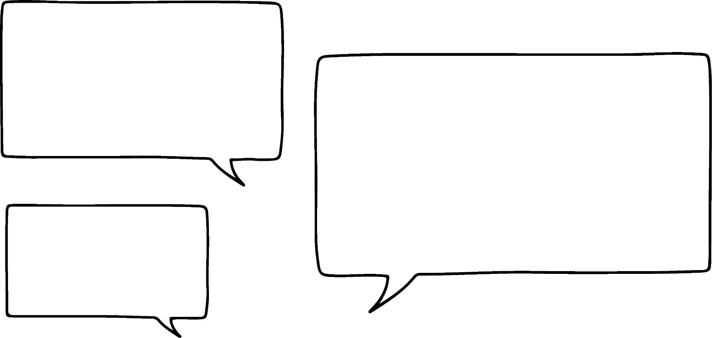
Simplifying multiplication using multiples of 10
3
× 10
× 10
7
÷ 10
÷ 10
÷ 10
× 10
× 10
210
×
300
0.7
300 × 0.7 = 210
3 × 100
×
7 × 0.1
So all of those × 10 and ÷ 10 function machines and all we needed to do was multiply the product of 3 and 7 by 10
3 × 7
×
100 × 0.1
21
×
10
= 210
Of course, because × 10 and ÷ 10 are inverses of each other

Slide 13
Simplifying multiplication using multiples of 10
300 × 0.7 = 210
3 × 100
×
7 × 0.1
×
100 × 0.1
I’ve also noticed that 7 × 0.1 = 0.7 and
7 ÷ 10 = 0.7
so, does that mean that × 0.1 is the same as ÷ 10?
3 × 7
21
×
10
= 210
Yes they are the same.
0.1 is one tenth of 1 and when you divide by ten you are finding a tenth of something.

Slide 14
Simplifying multiplication using multiples of 10
Is the product of 0.00007 and 30 000 less than, greater than or equal to 21?
0.00007 is 100 000 times less than 7
30 000 is 10 000 times greater than 3
Since 30 000 is only 10 000 times larger than 3, the product will be less than 21.

Slide 15

Simplifying multiplication using multiples of 10
The product of 0.0000007 and 3 000 000 is equal to 2.1
0.0000007 is 10 000 000 times smaller than 7 and 3 000 000 is 1 000 000 times larger than 3
0.0000007 is 1 000 000 times smaller than 7 and 3 000 000 is 1 000 000 times larger than 3

Slide 16
Simplifying multiplication using multiples of 10
4 × 6 = 24
Write products using the digits 0, 4 and 6 into the correct group.
0.4 × 60 = 24
0.04 × 6000 = 24
0.00004 × 60 000 = 24
0.0004 × 600 000 = 24
0.004 × 6000 = 24
0.0004 × 60 000 = 24
0.0004 × 6000 = 24
Less than 24
Equal to 24
Larger than 24
0.00004 × 60 000 = 2.4
0.4 × 60 = 24
0.04 × 6000 = 240
0.0004 × 6000 = 2.4
0.004 × 6000 = 24
0.0004 × 600 000 = 240
0.0004 × 60 000 = 24

Slide 17
Simplifying multiplication using multiples of 10
The product of 0.0004 and 60 000 is larger than 24.
60 000 has 4 zeros and 0.0004 only has 3 zeros after the decimal point.
60 000 is 10 000 times larger than 6 and 0.0004 is 10 000 times smaller than 4.

Slide 18
Simplifying multiplication using multiples of 10
Laura and Jun are working on this problem.
The decimal point or points have fallen out of this calculation.
The answer is correct, so where should the decimal point or points be in the question?
24 × 79 = 189.6
It must be
2.4 × 79 = 189.6
It must be
24 × 7.9 = 189.6
Can they both be right?
Yes they can. Laura has made 24 ten times smaller and Jun has made 79 ten times smaller.

Slide 19
Simplifying multiplication using multiples of 10
24 × 79 = 18.96
It must be
2.4 × 7.9 = 18.96
That can’t be right because
2 × 80 = 160. The answer has to be close to that.
It is
2.4 × 79 = 18.96
That makes more sense as 2 × 8 = 16.
Is that the only place for the decimal point?
No, it could be 0.24 × 79 for example if the decimal point can be at the beginning of a number.

Slide 20
Simplifying multiplication using multiples of 10
Which of the following have the decimal point in the correct place.
12.3 × 48 = 590.4
1.23 × 4.8 = 5.904
123 × 4.8 = 59.04
1.23 × 48 = 59.04

Slide 21
Simplifying multiplication using multiples of 10
Use a Gattegno chart to write down at least 4 pairs of numbers with a product of the following:
5
15
180
1600
2) Go beyond the Gattegno chart and write down at least 3 pairs of numbers with a product of the following:
42
300
8100

Slide 22
Simplifying multiplication using multiples of 10
3) Some of the decimal points have fallen out of these calculations!
Using these facts: 32 × 14 = 448 and 241 × 19 = 4579
Put the decimal points in the correct place in the question to get the given products.
32 × 14 = 4.48
32 × 14 = 0.448
32 × 14 = 44.8
241 × 19 = 45.79
241 × 19 = 457.9
241 × 19 = 4.579
4) Write some alternatives to your answers in question 3.

Slide 23
Simplifying multiplication using multiples of 10
Use a Gattegno chart to write down at least 4 pairs of numbers with a product of the following:
5 e.g. 1 × 5, 10 × 0.5, 0.1 × 50, 100 × 0.05
15 e.g. 3 × 5, 30 × 0.5, 0.3 × 50, 300 × 0.05
180 e.g. 20 × 9, 0.03 × 6000, 0.2 × 900, 3000 × 0.06
1600 e.g. 2 × 800, 0.4 × 4000, 0.8 × 2000, 40 × 40
2) Go beyond the Gattegno chart and write down at least 3 pairs of numbers with a product of the following:
42 e.g. 0.006 × 7000, 210 × 0.2, 0.001 × 42 000, 2.1 × 20
300 e.g. 30 × 10, 0.0015 × 200 000, 0.01 × 30 000, 600 × 0.5
8100 e.g. 900 000 × 0.009, 81 000 × 0.1, 300 × 0.27, 162 000 × 0.05

Slide 24
Simplifying multiplication using multiples of 10
3) Some of the decimal points have fallen out of these calculations!
Using these facts: 32 × 14 = 448 and 241 × 19 = 4579
Put the decimal points in the correct place in the question to get the given products.
32 × 14 = 4.48 e.g. 3.2 × 1.4
32 × 14 = 0.448 0.32 × 1.4
32 × 14 = 44.8 32 × 1.4
241 × 19 = 45.79 24.1 × 1.9
241 × 19 = 457.9 24.1 × 19
241 × 19 = 4.579 2.41 × 1.9
4) Write some alternatives to your answers in question 3.

Slide 25
Simplifying multiplication and division using multiples of 10
Simplifying multiplication using multiples of 10
Simplifying division using multiples of 10

Slide 26

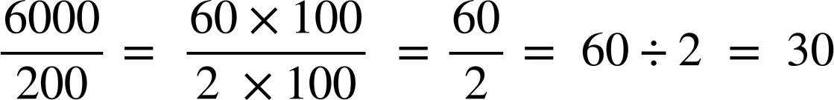
Simplifying division using multiples of 10
Partitioning can also help to simplify division.
Here we need to remember that division can be written as a fraction.
You could change it back into a division to simplify or just simplify the fraction.
Write as factor pairs, with a common factor. For efficiency try to use the HCF.

Slide 27
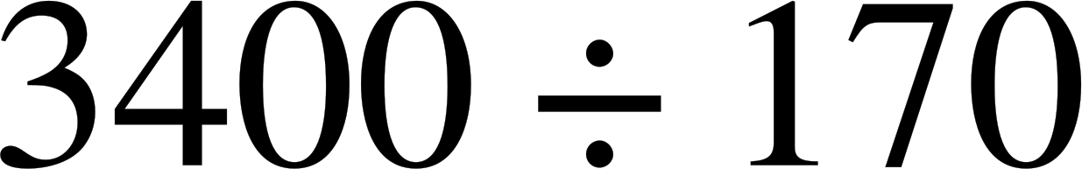
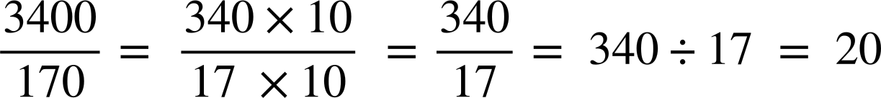
Simplifying division using multiples of 10
Partitioning can also help to simplify division.
Write as a fraction
You could change it back into a division to simplify or just simplify the fraction.
Write as factor pairs, with a common factor. For efficiency try to use the HCF.

Slide 28


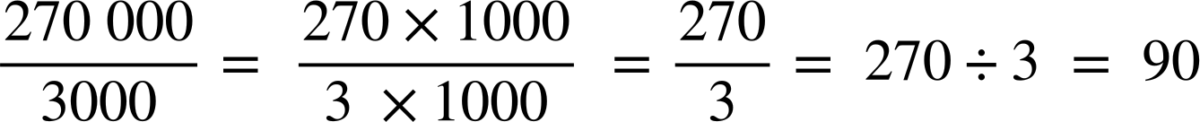
Simplifying division using multiples of 10

Slide 29
Simplifying division using multiples of 10
Answer the following questions. Find and shade them in the grid to reveal a number.
36 000 ÷ 120
4800 ÷ 240
600 000 ÷ 500
4 500 000 ÷ 300 000
5) 42 000 000 ÷ 6000
6) 96 000 ÷ 24 000
7) 300 000 ÷ 6000
8) 880 000 ÷ 8000
300 | 20 | 1200 | 40 | 15 | 20 | 50 | 500 | 4 | 7000 | 300
200 | 30 | 15 | 150 | 7000 | 200 | 7000 | 150 | 15 | 200 | 110
110 | 7000 | 300 | 120 | 110 | 4 | 300 | 700 | 20 | 30 | 1200
120 | 700 | 50 | 500 | 20 | 150 | 15 | 40 | 7000 | 120 | 15
4 | 110 | 20 | 1100 | 300 | 1200 | 20 | 150 | 1200 | 50 | 4

Slide 30
Simplifying division using multiples of 10
Answer the following questions. Find and shade them in the grid to reveal a number.
36 000 ÷ 120 = 300
4800 ÷ 240 = 20
600 000 ÷ 500 = 1200
4 500 000 ÷ 300 000 = 15
5) 42 000 000 ÷ 6000 = 7000
6) 96 000 ÷ 24 000 = 4
7) 300 000 ÷ 6000 = 50
8) 880 000 ÷ 8000 = 110
300 | 20 | 1200 | 40 | 15 | 20 | 50 | 500 | 4 | 7000 | 300
200 | 30 | 15 | 150 | 7000 | 200 | 7000 | 150 | 15 | 200 | 110
110 | 7000 | 300 | 120 | 110 | 4 | 300 | 700 | 20 | 30 | 1200
120 | 700 | 50 | 500 | 20 | 150 | 15 | 40 | 7000 | 120 | 15
4 | 110 | 20 | 1100 | 300 | 1200 | 20 | 150 | 1200 | 50 | 4

Slide 31
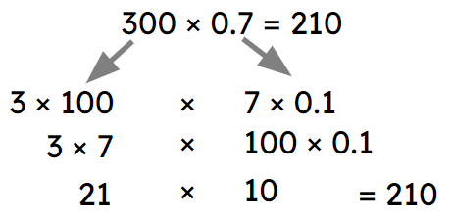

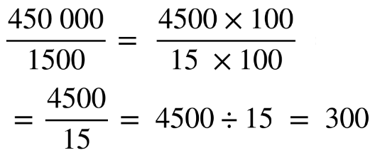
Simplifying multiplication and division using multiples of 10
Multiples of 10^{n} can be used to simplify both multiplication and division.
E.g.
Dividing by 10 is equivalent to multiplying by 0.1.
It is important to consider place value when working with decimals.

Slide 32

© Oak National Academy 2023.
Produced in partnership with Mathematics in Education and Industry.
Licensed on the Open Government Licence v3.0, except where otherwise stated. See Oak terms and conditions.

